Slide 1
Azure Firewall Premium & Firewall Manager Demo

Slide 3
Firewall Manager - Policies
Managed centrally from Firewall Manager
Applied to Firewall instances globally
Hierarchical: Parent Policy -> Child Policy -> Firewall instance
Rule types:
DNAT -> for inbound connectivity
Network -> Layer 3 / 4
source/destination as IP Address, IP Groups, FQDN, Service Tags
Application -> Layer 7 Proxy
source as IP Address, IP Groups
destination as FQDN, FQDN Tags, Web Category (Premium) or URL (Premium)
Threat Intelligence
TLS Inspection (Premium)
IDPS (Premium)

Slide 4
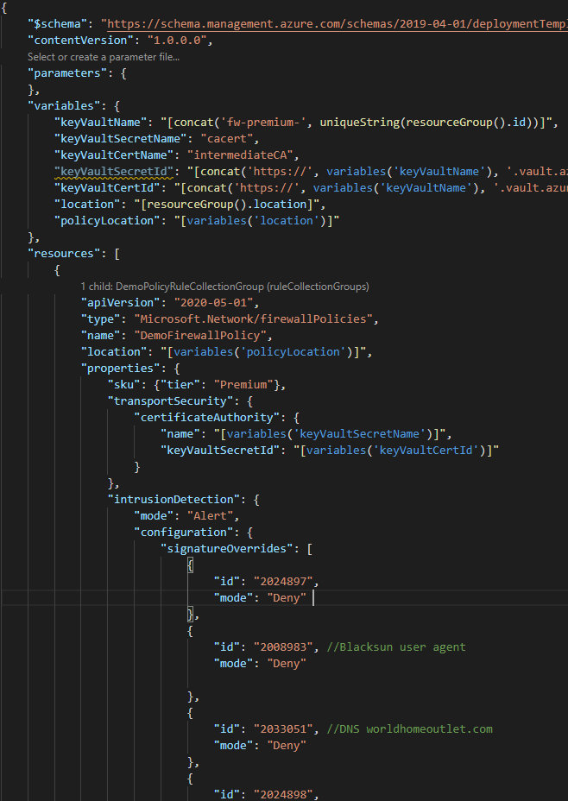
Policy deployment as code
Firewall Policies are ARM top-level resources
Deployable through ARM templates, Bicep or 3rd party IaC tooling
Can be included in deployment pipelines
Have independent RBAC access control

Slide 5
DNAT Rules – Inbound Destination NAT

Slide 6
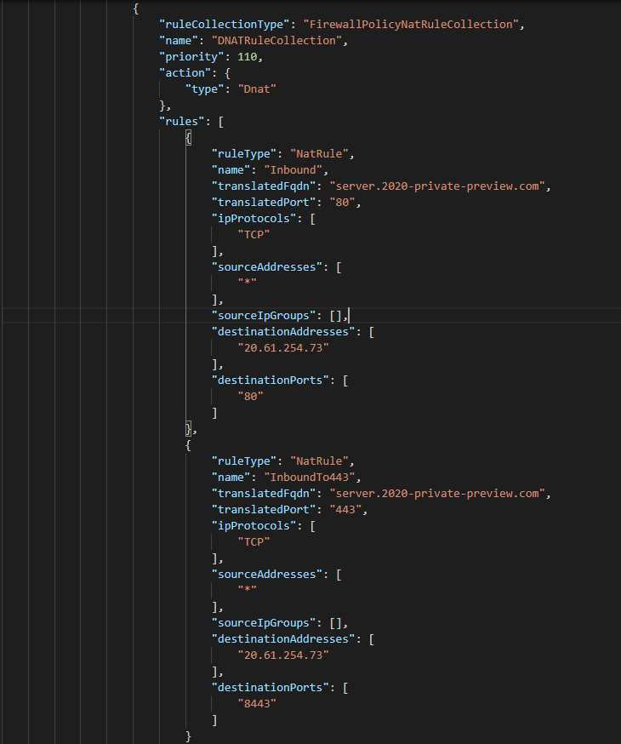
DNAT Rules – Inbound Destination NAT
From a workstation on the internet to a web server inside our network:
Browse to http://azfwpremium.dedroog.net
Inbound connection is translated to private address of Server VM 10.0.20.4 on port 80
Browse https:// azfwpremium.dedroog.net
Inbound connection is translated to private address of Server VM 10.0.20.4 on port 443

Slide 7
Application Rule – URL filtering

Slide 8
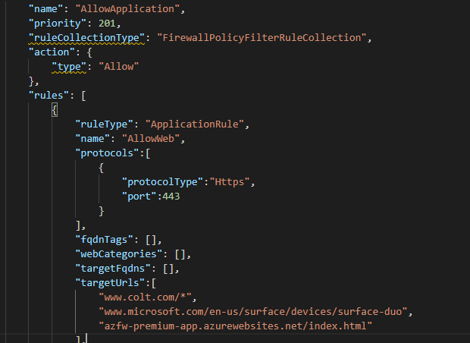
Application Rule – URL filtering
From a Worker VM in our network
to a web server on the internet
Browse to https://azfw-premium-app.azurewebsites.net/index.html --ssl-no-revoke
Policy match for this URL on port 443
Azure Firewall Premium demo site
TLS: generic certificate for *.azurewebsites.net
Browse to https://azfw-premium-app.azurewebsites.net/forbidden.html --ssl-no-revoke
HTTPS request from 10.0.10.10:52818 to azfw-premium-app.azurewebsites.net:443. Url: azfw-premium-app.azurewebsites.net/forbidden.html. Action: Deny. No rule matched. Proceeding with default action
NB: URL inspection with https requires TLS inspection

Slide 9
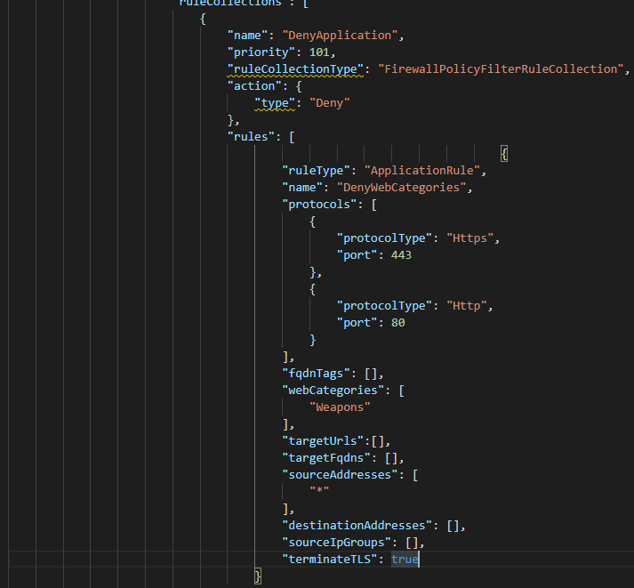

Application Rule – Web Category
From a Worker VM in our network
to a web server on the internet
Browse to www.colt.com
Firewall blocks connection because of web category:
HTTPS request from 10.0.10.10:54432 to www.colt.com:443. Url: www.colt.com. Action: Deny. Policy: DemoFirewallPolicy. Rule Collection Group: DemoPolicyRuleCollectionGroup. Rule Collection: DenyApplication. Rule: DenyWebCategories. Web Category: Weapons

Slide 10
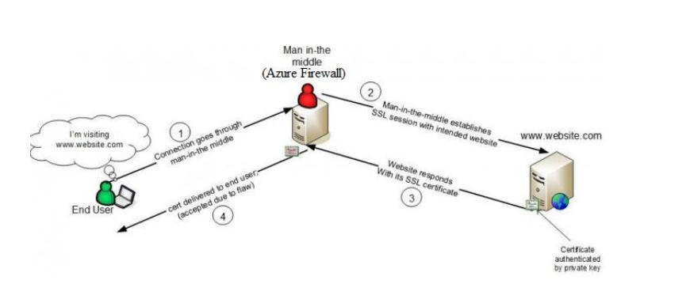
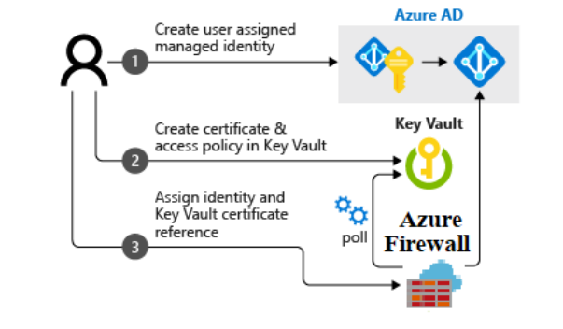
TLS Inspection

Slide 11
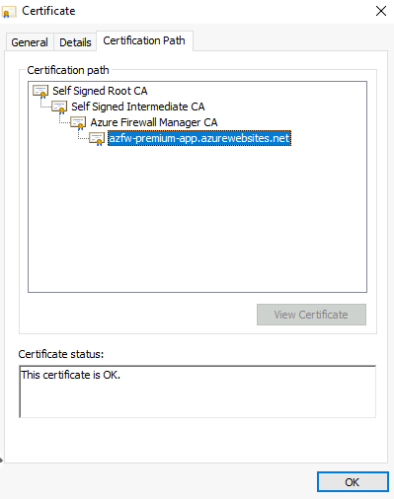
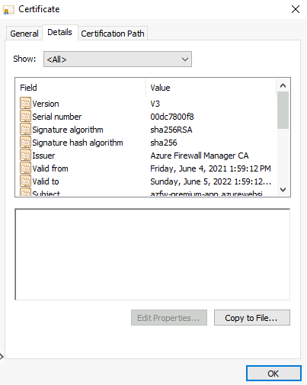
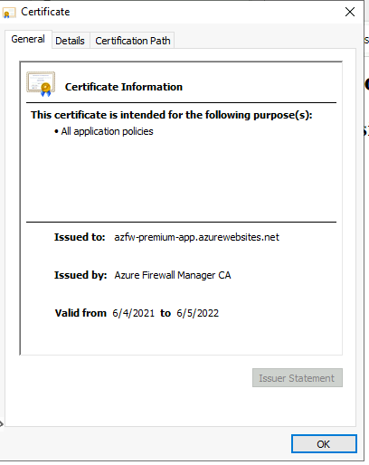
TLS Inspection
From a Worker VM in our network
to a web server on the internet
Browse to https://azfw-premium-app.azurewebsites.net/
Inspect certificate properties
Observe certificate was issued from Azure Firewall
Root cert must be installed on Worker VM

Slide 12
IDPS – HTTP/S
From a Worker VM in our network
to a web server on the internet
curl https://azfw-premium-app.azurewebsites.net/ --ssl-no-revoke
Observe normal server response:
<h1>Azure Firewall Premium demo site</h1>
<h2>TLS: generic certificate for *.azurewebsites.net</h2>
In Firewall Policy under IDPS, set Signature rule for ID 2008983 to deny
Insert User-Agent header with value “BlackSun” in https request
curl -A "BlackSun" https://azfw-premium-app.azurewebsites.net/ --ssl-no-revoke
Observe no response received
Verify in logs in Monitor that ID 2008983 was triggered

Slide 13
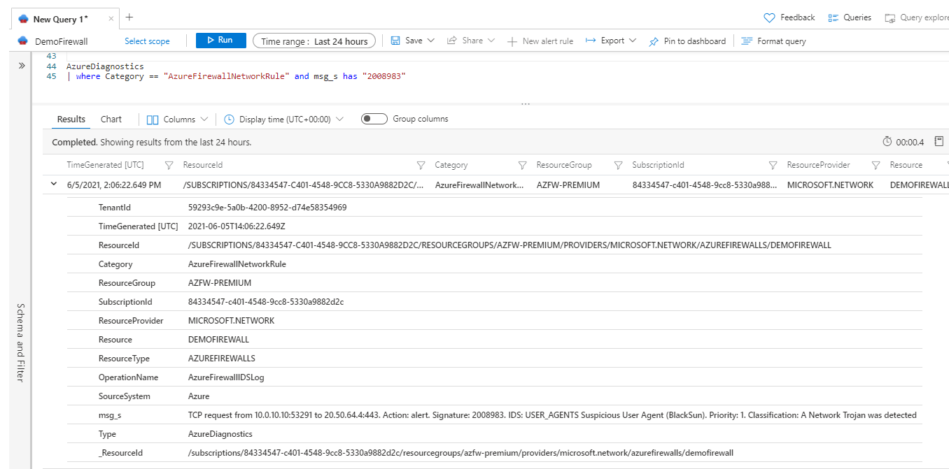

Slide 14
IDPS - DNS
From a Worker VM in our network
to a web server on the internet
In Firewall Policy under IDPS, set Signature rule for ID 2033051 to Deny
Set WorkerVM to query external DNS, Azure platform DNS at 168.63.129.16 is not forced through firewall
NSLOOKUP
server 8.8.8.8
Worldhomeoutlet.com
Observe no response to DNS query received
Verify in logs in Monitor that ID 2033051 was triggered

Slide 15
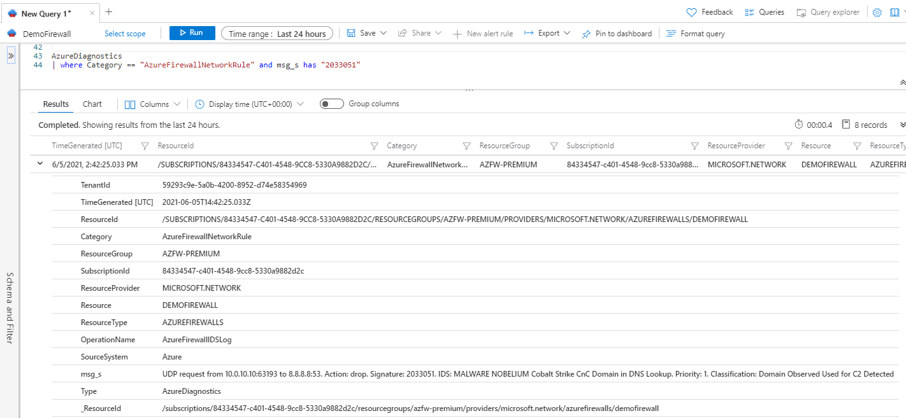

Slide 16
IDPS Signatures
https://rules.emergingthreats.net/open/suricata/emerging-all.rules
alert http $HOME_NET any -> $EXTERNAL_NET any (msg:"ET USER_AGENTS Suspicious User Agent (BlackSun)"; flow:to_server,established; content:"BlackSun"; nocase; http_user_agent; depth:8; reference:url,www.bitdefender.com/VIRUS-1000328-en--Trojan.Pws.Wow.NCY.html; reference:url,doc.emergingthreats.net/bin/view/Main/2008983; classtype:trojan-activity; sid:2008983; rev:7; metadata:created_at 2010_07_30, former_category HUNTING, updated_at 2020_10_13;)
alert dns $HOME_NET any -> any any (msg:"ET TROJAN NOBELIUM Cobalt Strike CnC Domain in DNS Lookup"; dns_query; content:"worldhomeoutlet.com"; nocase; isdataat:!1,relative; pcre:"/(?:^|\.)worldhomeoutlet\.com$/"; reference:url,www.microsoft.com/security/blog/2021/05/27/new-sophisticated-email-based-attack-from-nobelium/; classtype:trojan-activity; sid:2033051; rev:2; metadata:affected_product Windows_XP_Vista_7_8_10_Server_32_64_Bit, attack_target Client_Endpoint, created_at 2021_05_28, deployment Perimeter, malware_family Cobalt_Strike, performance_impact Low, signature_severity Major, updated_at 2021_05_28;)

Slide 17
Logs
AzureDiagnostics | where ResourceType == "AZUREFIREWALLS“ | summarize by OperationName
AzureDiagnostics
| where ResourceType == "AZUREFIREWALLS"
| summarize by Category
AzureDiagnostics
| where ResourceType == "AZUREFIREWALLS"
| where OperationName == "AzureFirewallIDSLog"
OperationName AzureFirewallDnsProxyLog AzureFirewallApplicationRuleLog AzureFirewallDNSResolutionFailureLog AzureFirewallNatRuleLog AzureFirewallNetworkRuleLog AzureFirewallIDSLog AzureFirewallThreatIntelLog
Category AzureFirewallApplicationRule AzureFirewallDnsProxy AzureFirewallNetworkRule

Slide 18
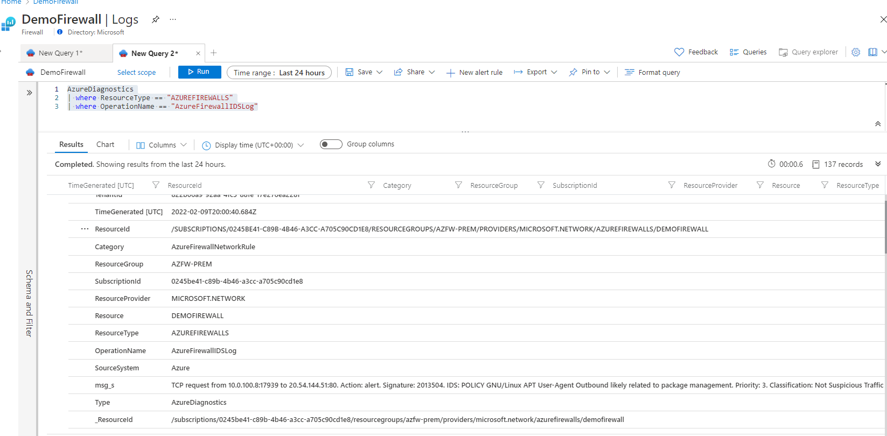

Slide 19
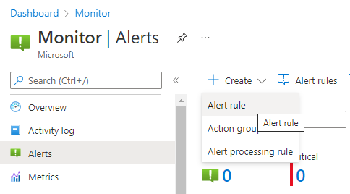
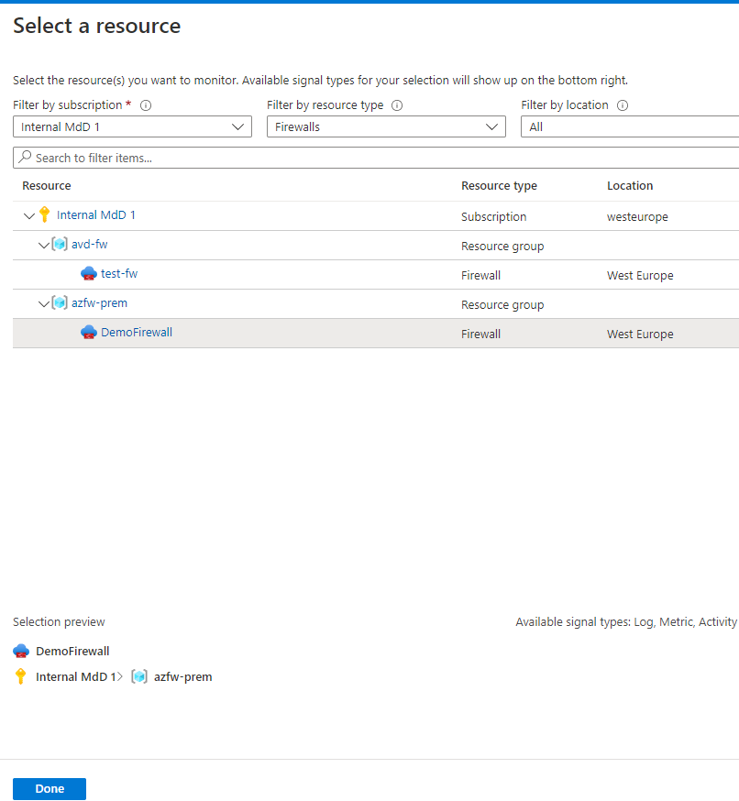
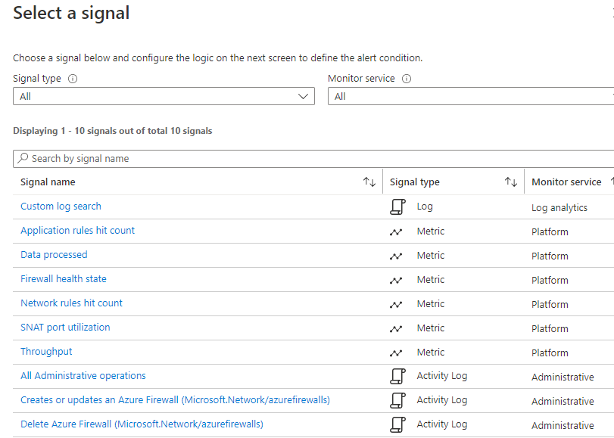
Send alert on IDPS detection
Azure Monitor -> Alerts -> + Create -> Alert Rule
Scope -> Azure Firewall instance
Condition -> Select a Signal -> Custom Log Search
Write log query for IDPS rule
AzureDiagnostics
| where ResourceType == "AZUREFIREWALLS"
| where OperationName == "AzureFirewallIDSLog" and msg_s has "2008983“
Complete Alert Logic
See final alert query, test in Log Analytics
Actions -> Add Action Group
Details -> Alert Rule Name

Slide 20
